Slide 1
TopoBaty2014
Testing LiDAR mapping of the coastal zone in Norway
Hilde Sande Norwegian Hydrographic Service
Erik Werenskiold: Vannkikkere, Nasjonalmuseet

Slide 2
The Norwegian Hydrographic Service
Division in the Norwegian Mapping Authority
140 employees, based in Stavanger
One survey vessel, two survey launches
Responsible for mapping the Norwegian waters
The only authorised producer of official nautical charts in Norway
National administrator of bathymetric data
ISO certified

Slide 3
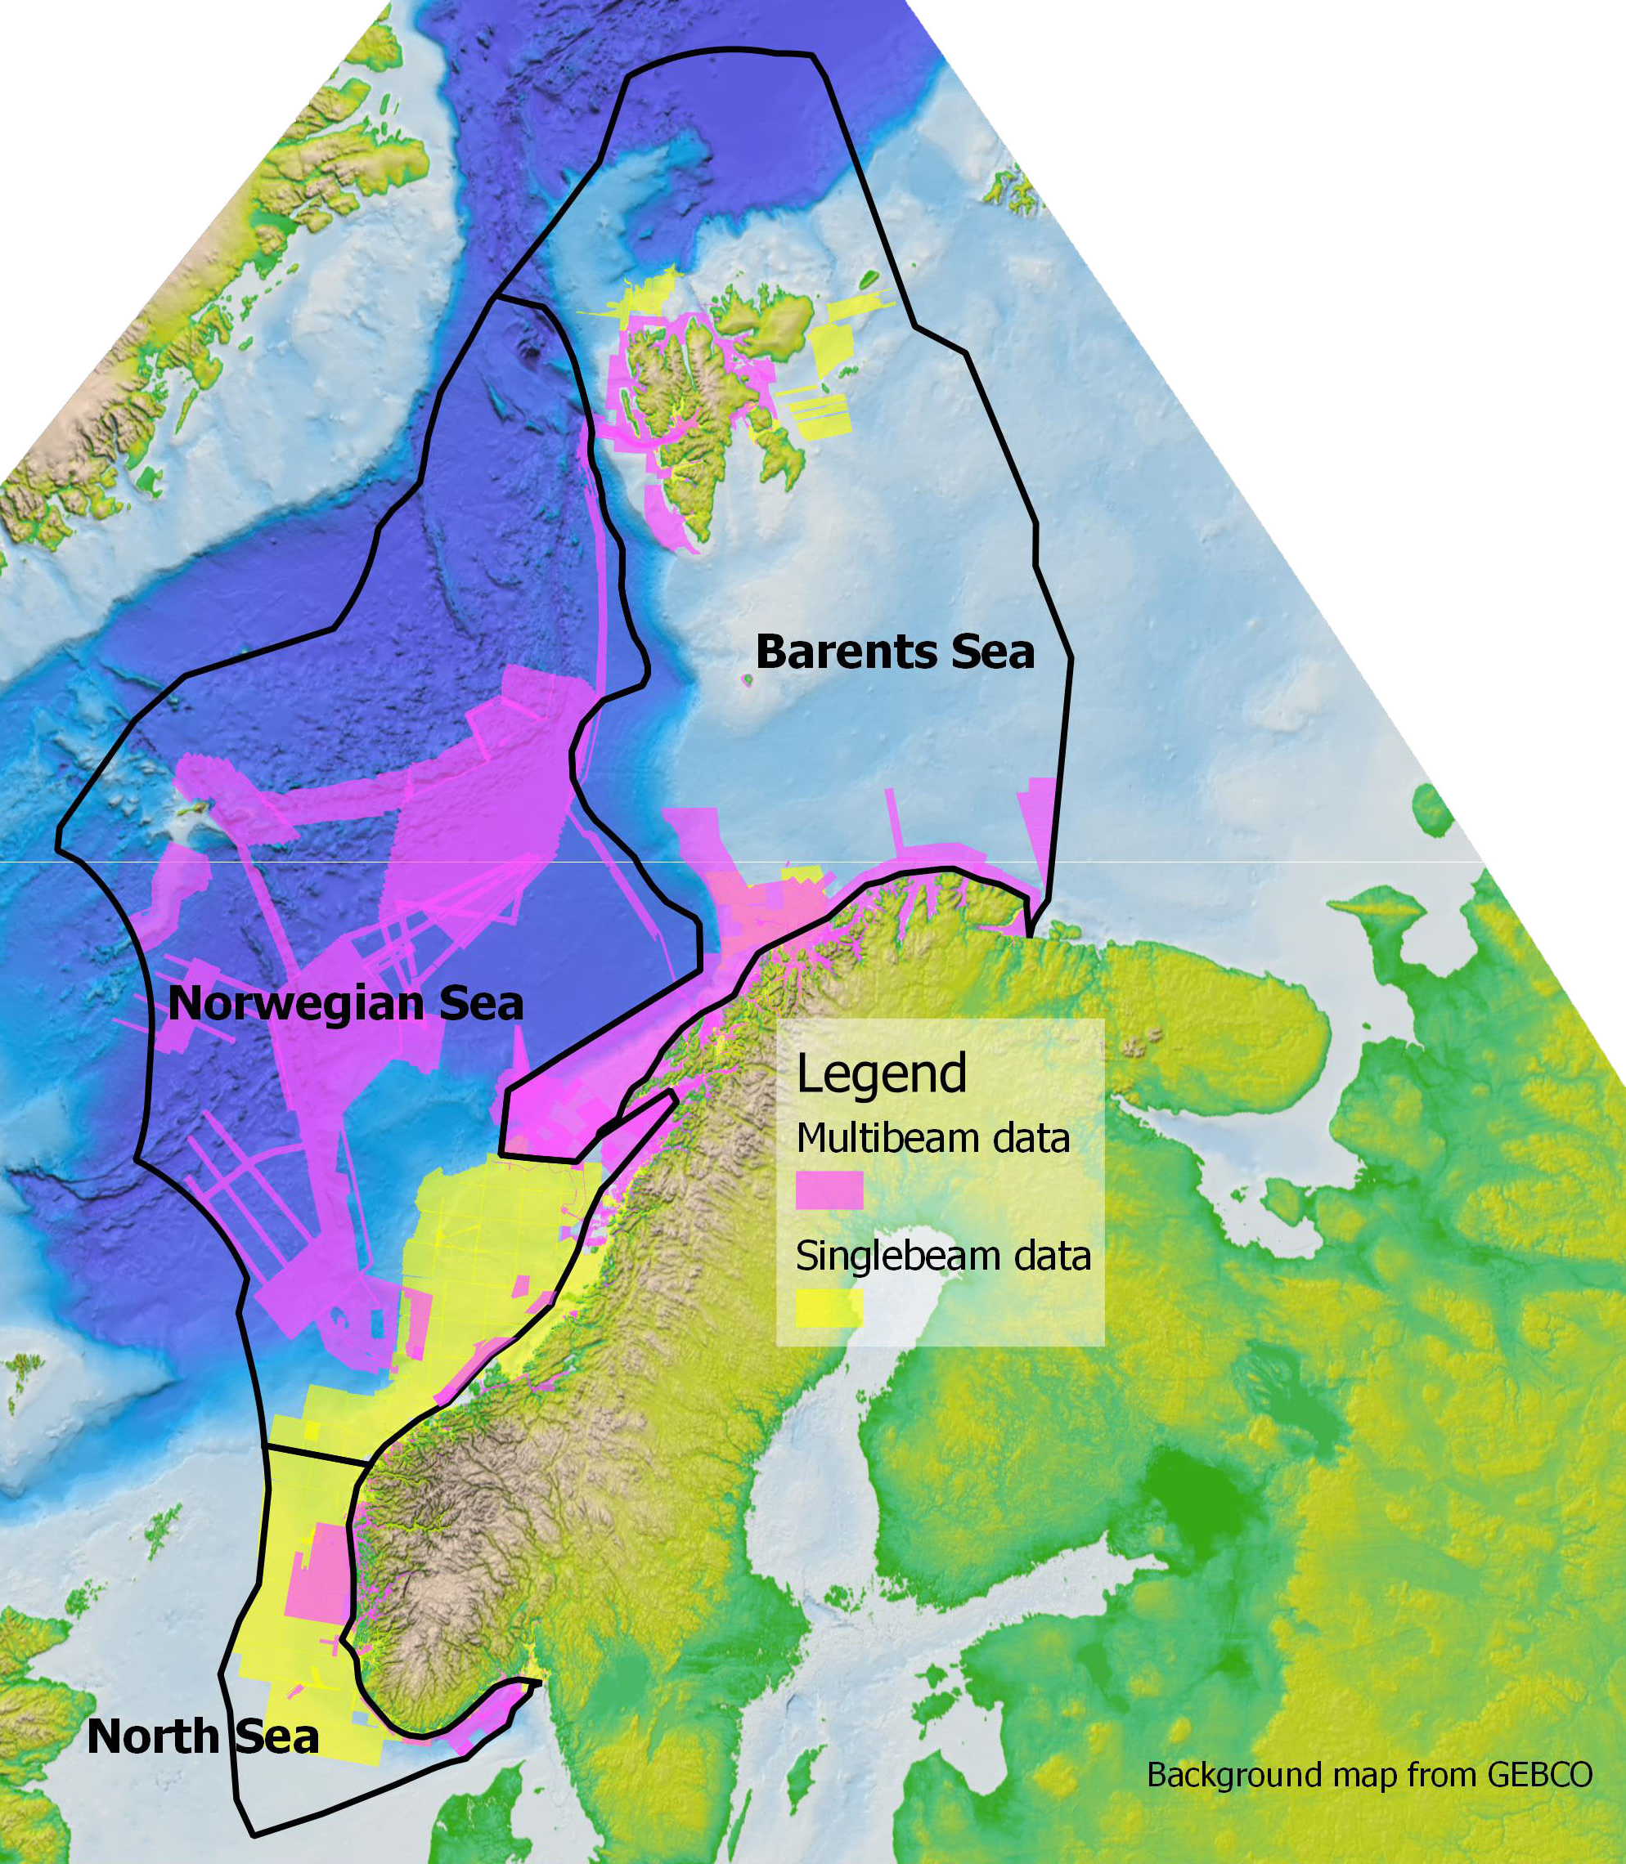
Norwegian Waters
Area of responsibility: 2,3 million km²
The Norwegian coastline: 100 915 km
239 057 islands
Nautical charts:
235 paper charts
1083 ENCs

Slide 4
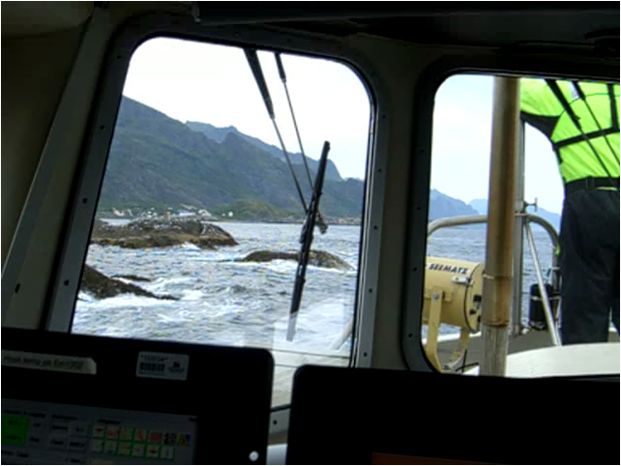
Testing LiDAR mapping More cost effective data collection possible?

Slide 5
Testing LiDAR Mapping Seamless data collection from sea to land

Slide 6
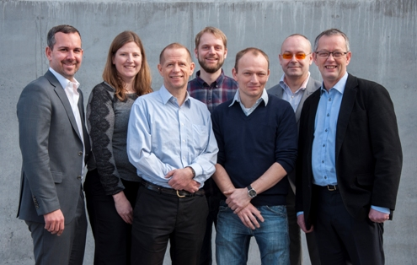
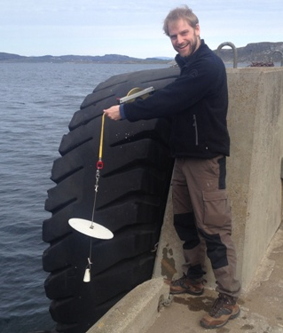
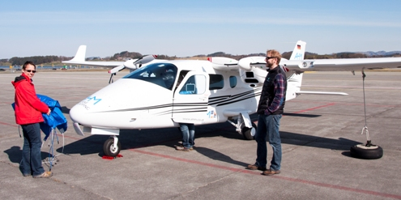
Pilot: TopoBaty 2014
Budget: 1 million NOK
Contractor: NIRAS
Subcontractor: AirborneHydroMapping
System: Riegl VQ820 – G
Data collection: April 2014
Data delivery: August 2014
Project report: November 2014

Slide 7
Ten areas Small areas with different challenges, 0 – 5 m depth

Slide 8
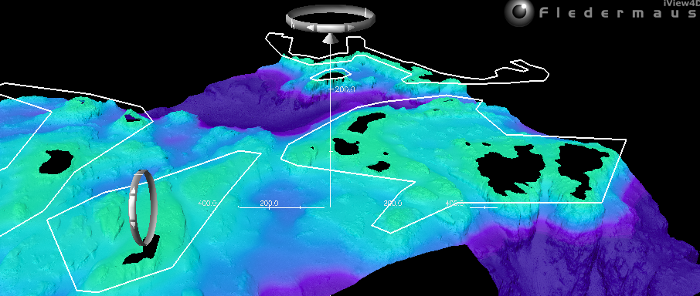
Test sites Have good multibeam data

Slide 9
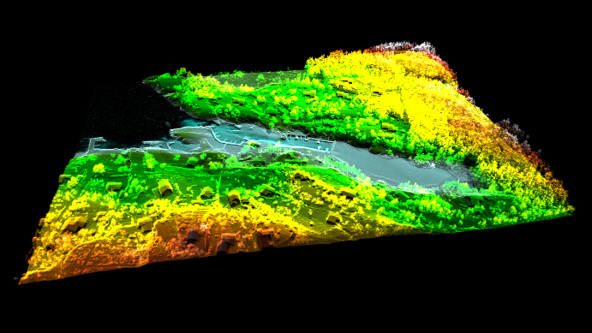
Lyngholmen

Slide 10
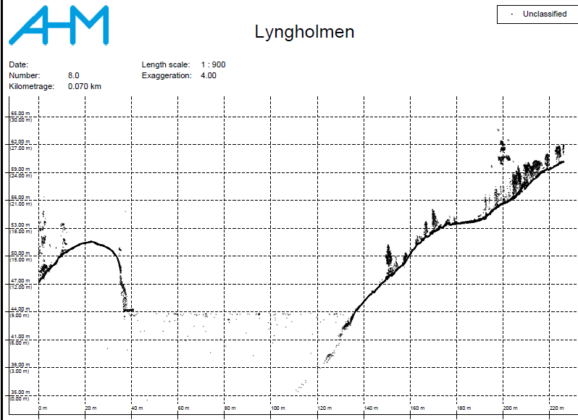
Lyngholmen

Slide 11
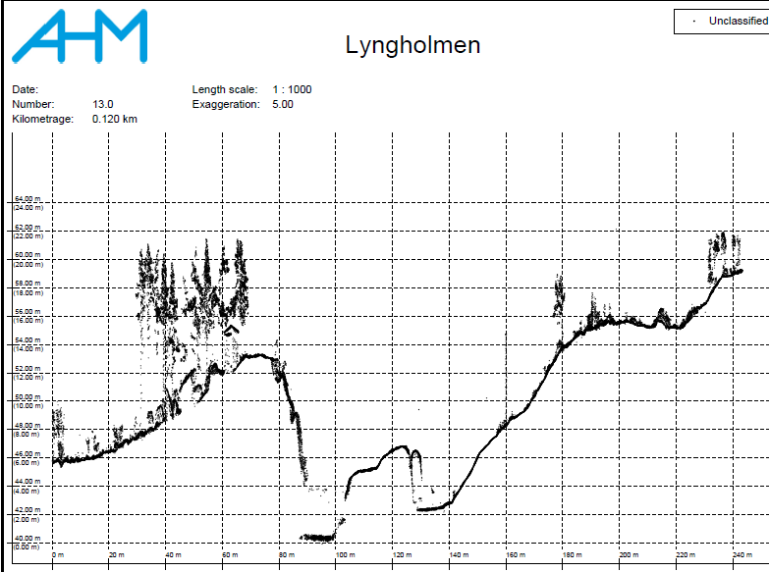
Lyngholmen

Slide 12
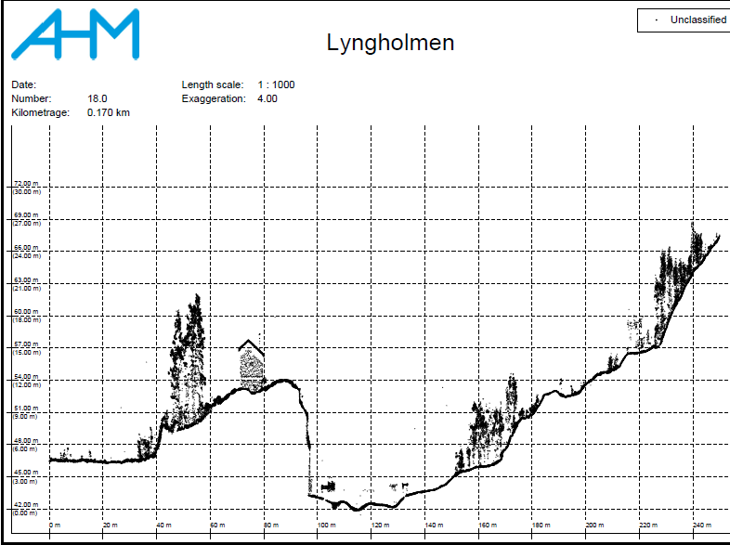
Lyngholmen

Slide 13
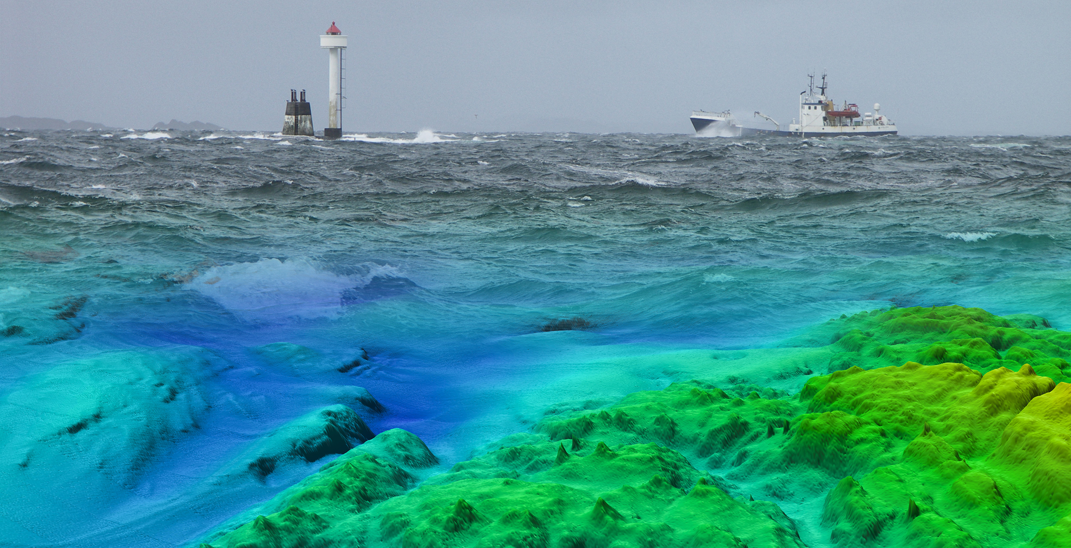
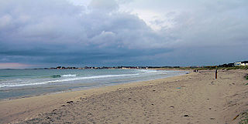
Waves

Slide 14
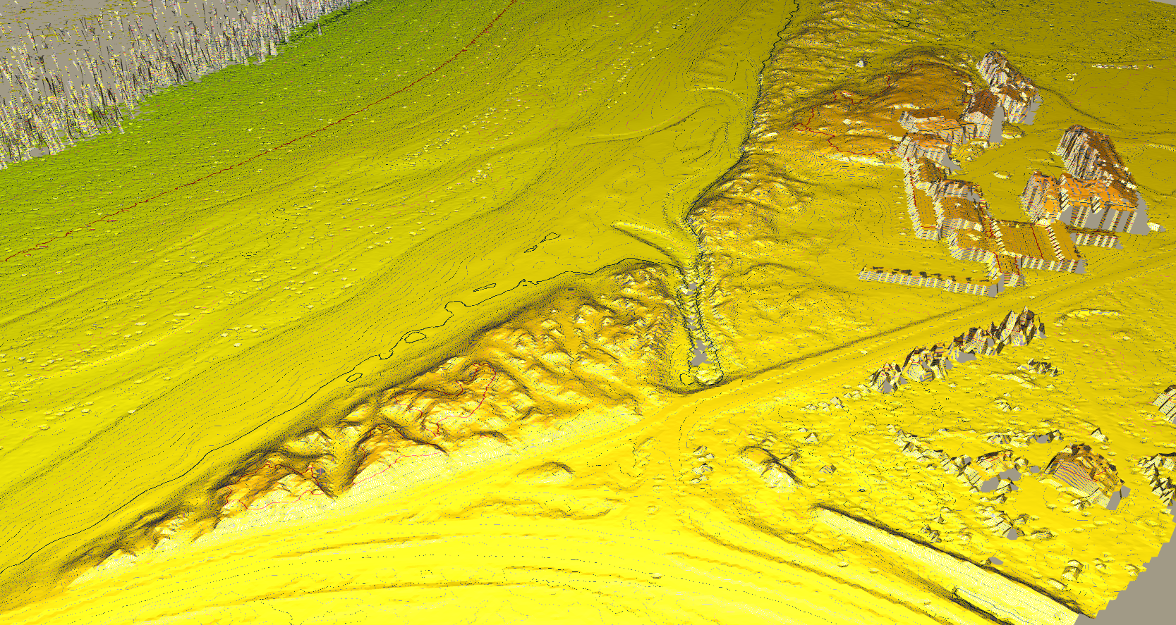
Waves

Slide 15
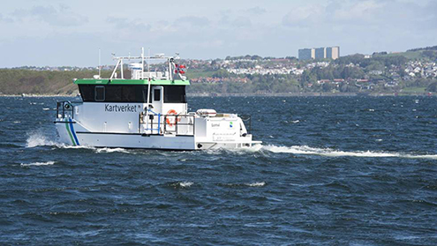
Airport, water quality

Slide 16
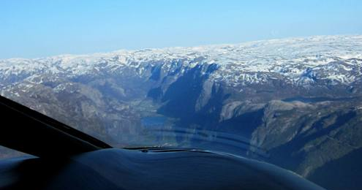
Steep mountains

Slide 17
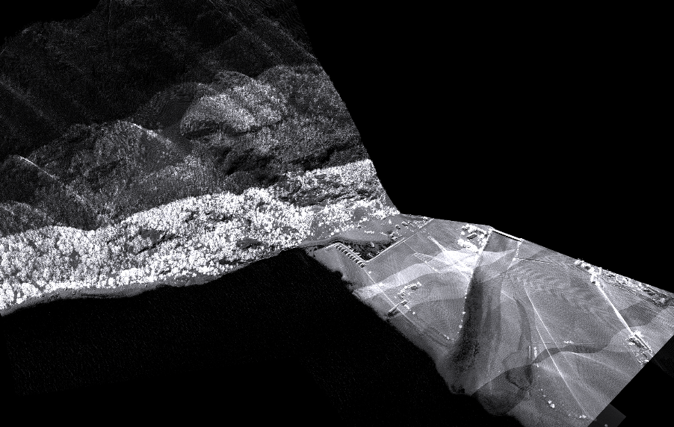
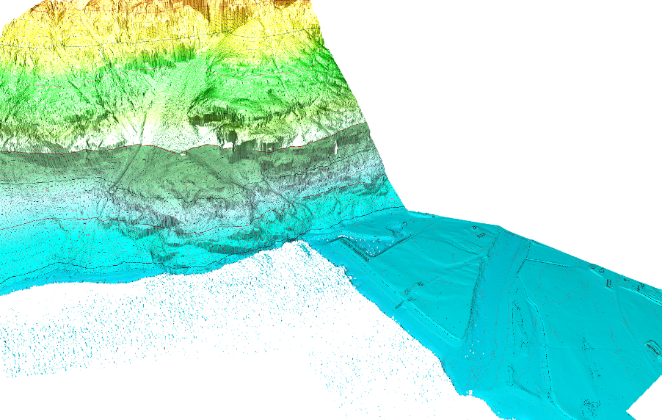
Frafjord

Slide 18
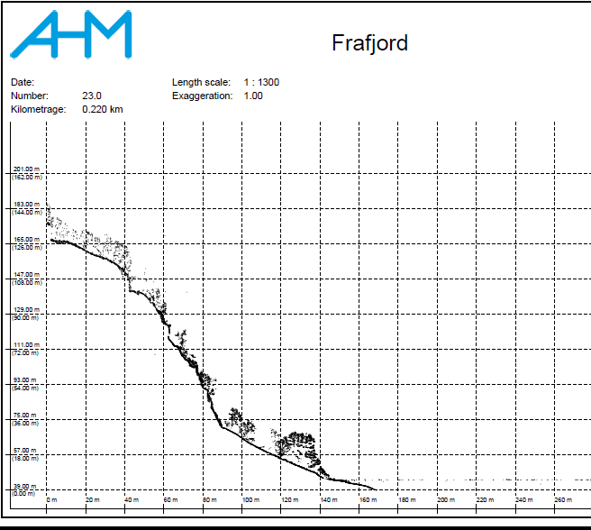
Frafjord

Slide 19
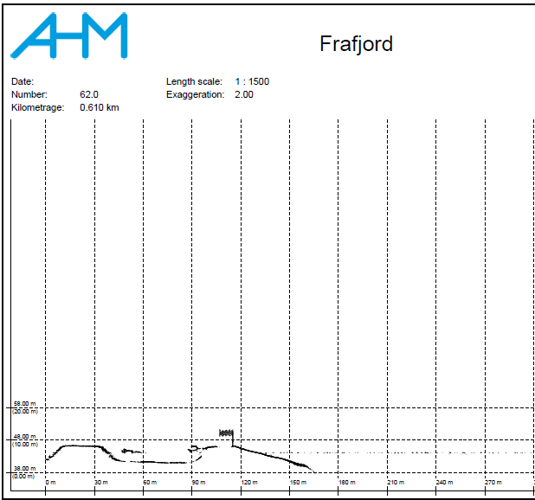
Frafjord

Slide 20
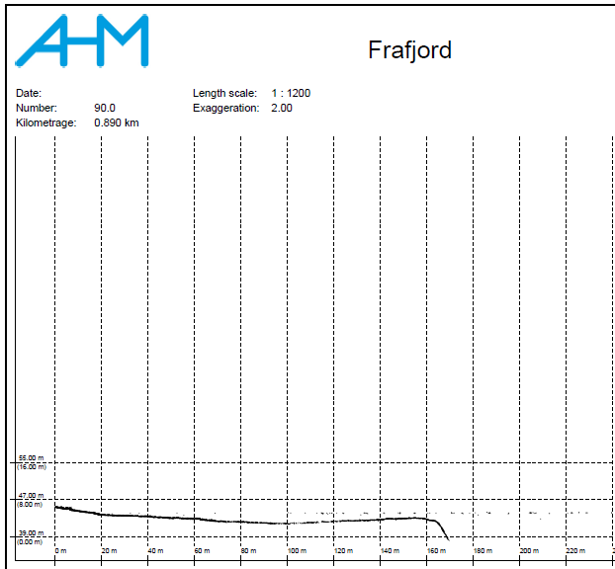
Frafjord

Slide 21
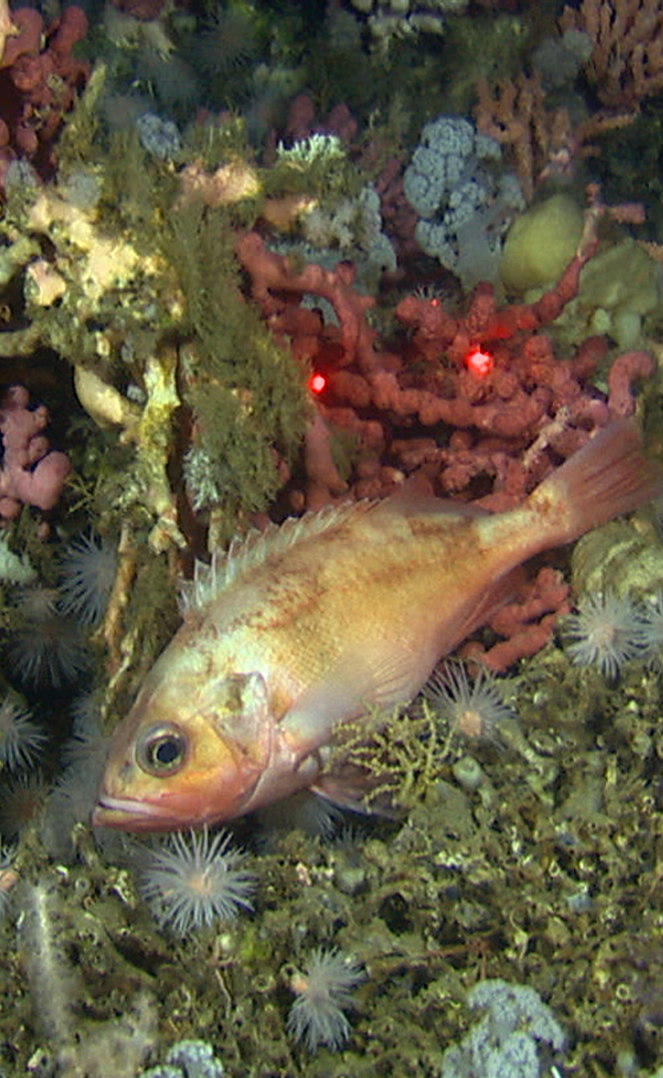
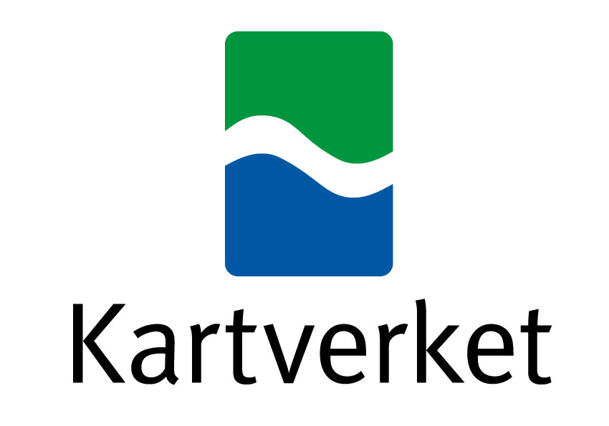
Marine Spatial Planning

Slide 22
Future project in Troms
Total: 15 270 km²
Left to survey:
2 378 km² at sea
245 km² 0-2 m
LiDAR can cover:
455 km²

Slide 23
Future project in Troms
 | Lidar 0-5 + trad | Tradisjonell
Tørrfall | 8 mill | Umulig
0-5 | 7 mill | 90 mill
Resten | 71 mill | 71 mill
Totalt | 86 mill | 161 mill

