Slide 1
BSHC LIDAR Seminar
SMA experiences from and
future plans of LIDAR surveys

Slide 2
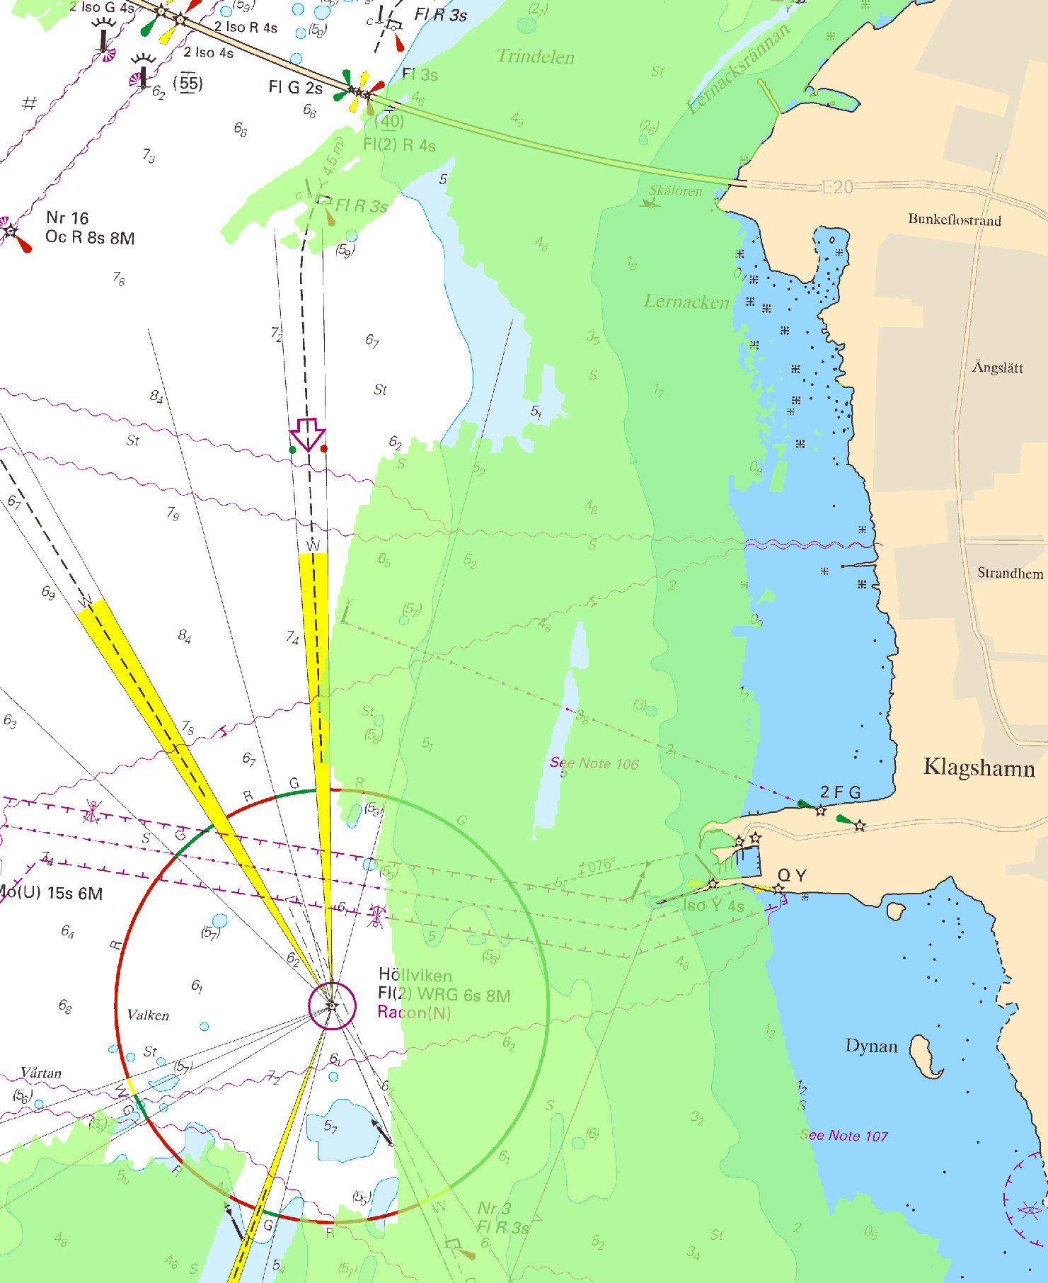
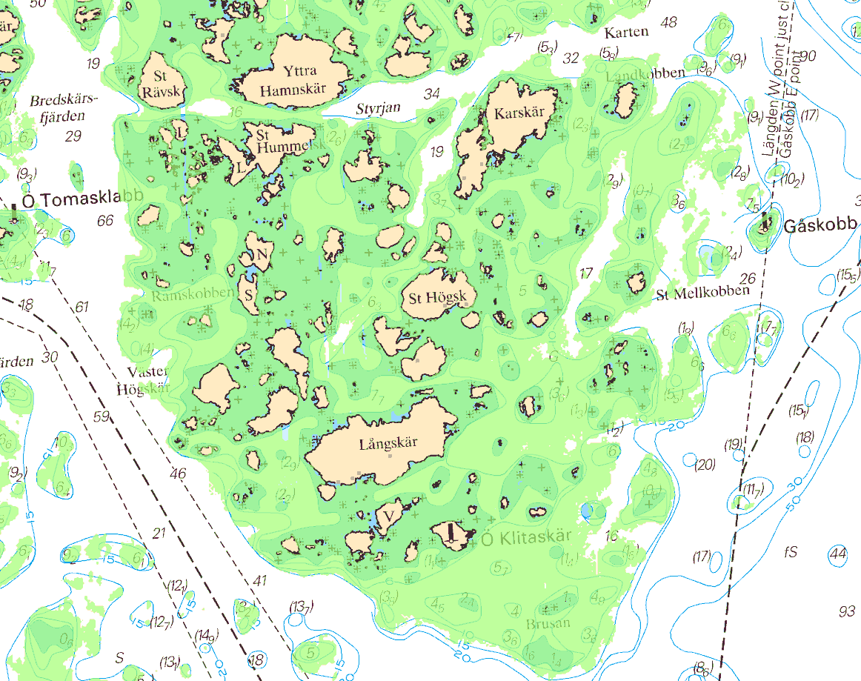
SMA LIDAR surveys 1996-2002
System: HawkEye I
Carrier: Helicopter
Positioning: DGPS
Depth range: ~1-20 m
Sounding density: ~5 per 5x5 m
LIDAR surveys along the coast of Skåne and Öland
LIDAR and multibeam surveys in the Stockholm archipelago, partly for the Navy
~6,6 km
~5 km
Common problems:
Any existing depths/contours shallower than the LIDAR-result were kept in the chart
How to handle single LIDAR sounding indicating shallow spot

Slide 3
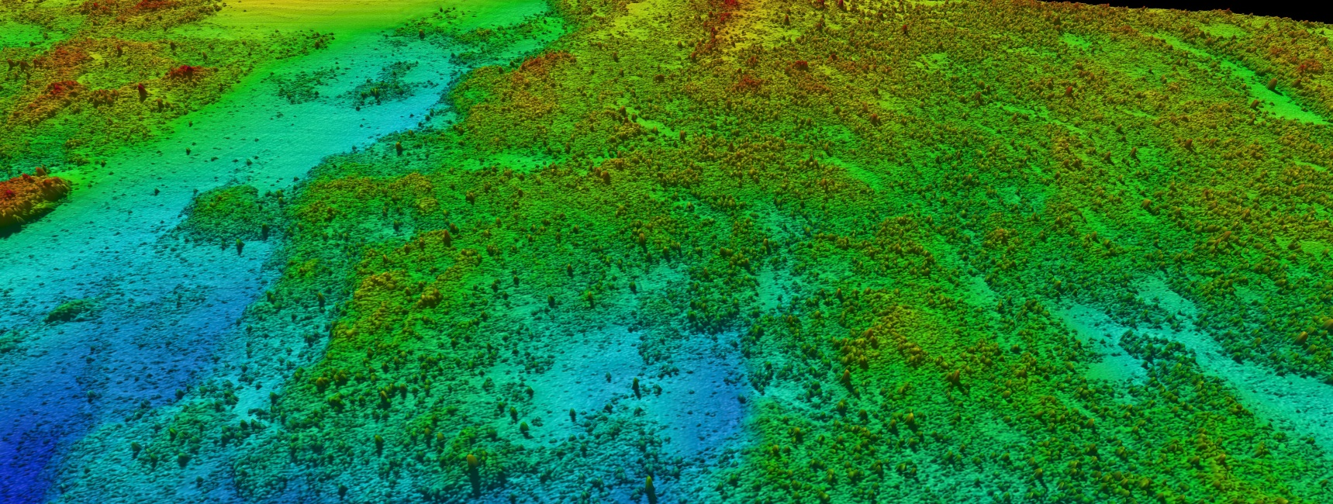
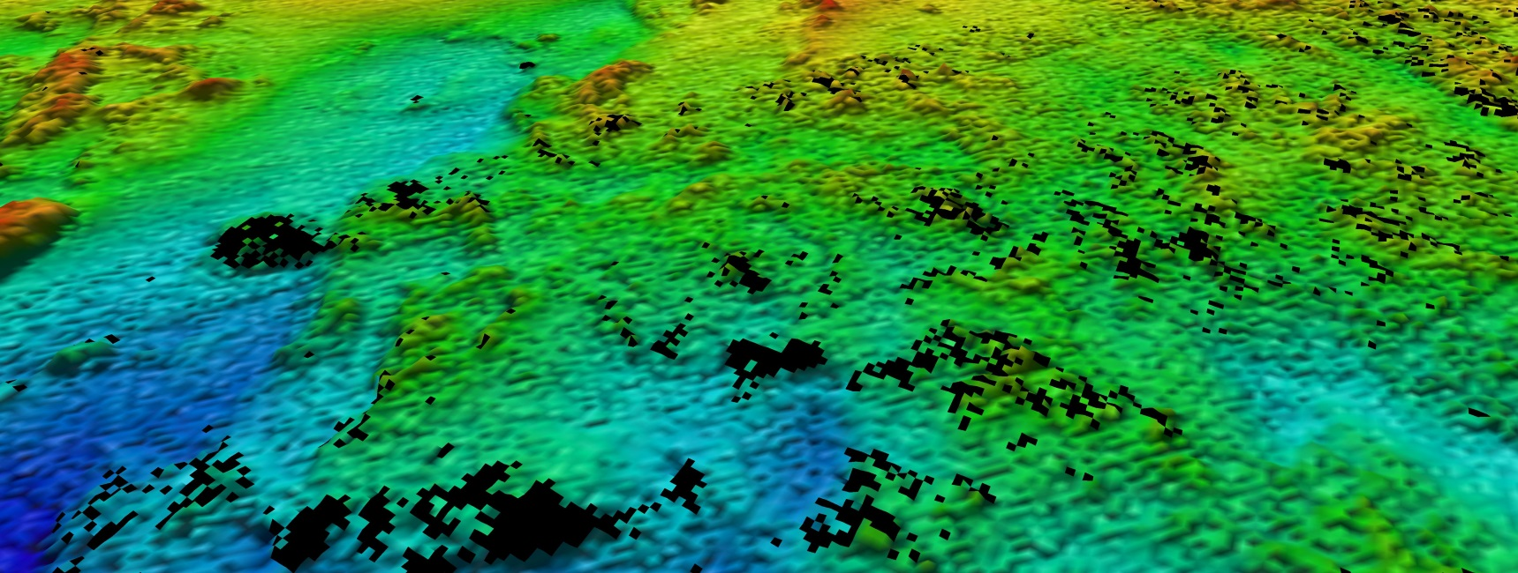
Recent LIDAR experiences from the research program EMMA (Environmental Mapping and Monitoring with Airborne laser and digital images on land and at sea)
Left picture: Multibeam Reson 7125 (2013), 1x1 m bin size. An enormous number of rocks/boulders.
Comparative surfaces, ~1000x750 m, depth range 2,5-11 m
Right picture: Hawkeye II (2010), 5x5 m bin size. In general, similar picture of the sea floor as for the multibeam, except the total absence of features/rocks. Gaps in data - no bottom reflect signal. Low sounding density -> low DTM resolution

Slide 4
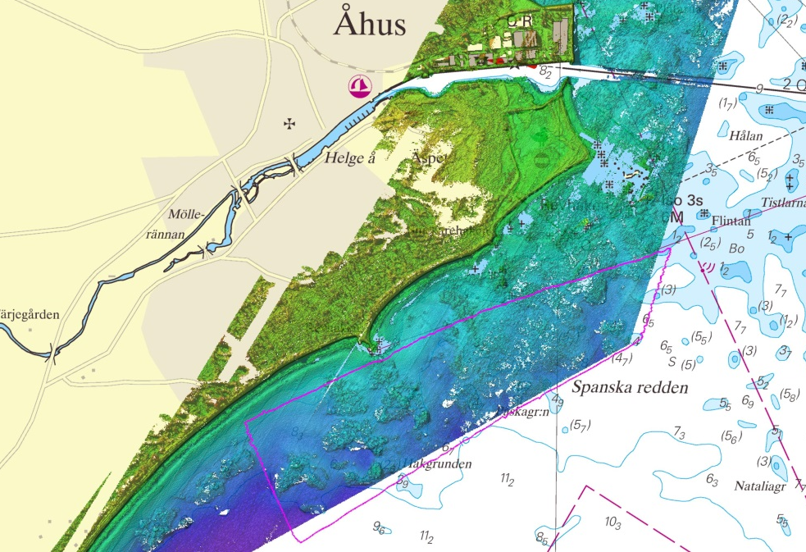
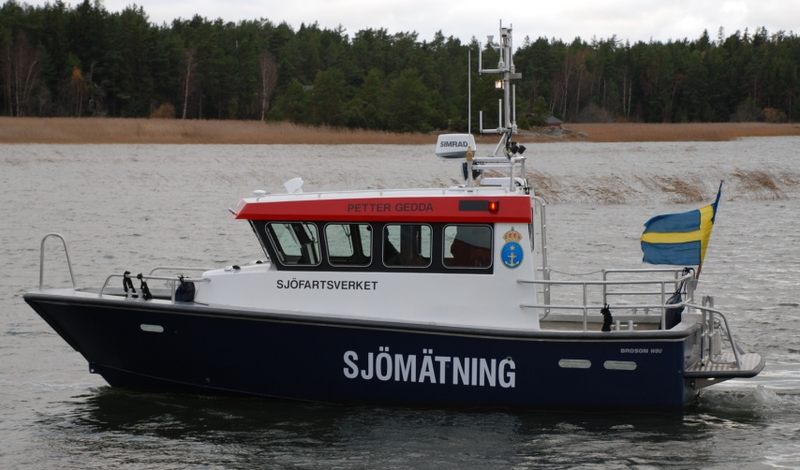
Uppmätta ytor - översiktsbilder
Sjömätt med lidar 2010
System: Hawkeye II
Positionering: PPK
Ger djupdata & intensitetsvärden
Maxdjup Åhus ca 13 m
Sjömätt med multibeam-ekolod 2013
Fartyg: Petter Gedda
System: Reson 7125 SV2 400 kHz (FP1)
Positionering: RTK
Ger djupdata & backscatter
Sjömätt med lidar 2012
System: Chiroptera
Positionering: PPK
Ger djupdata & intensitetsvärden
Maxdjup Åhus ca 4-6 m

Slide 5
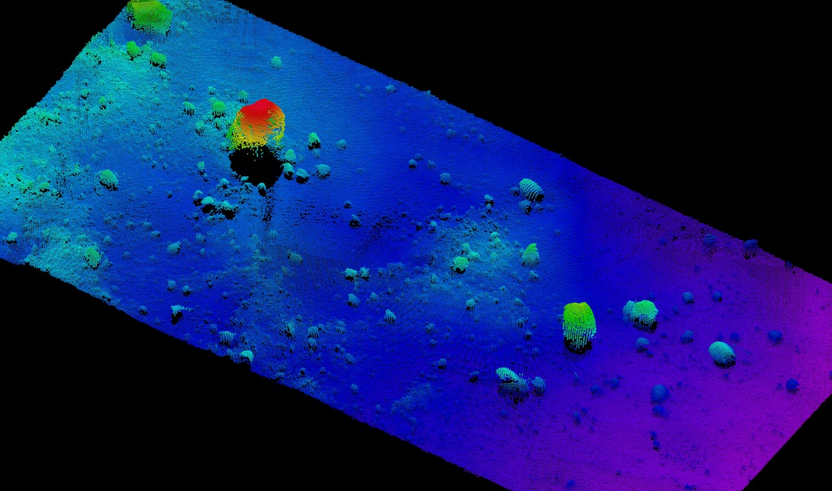
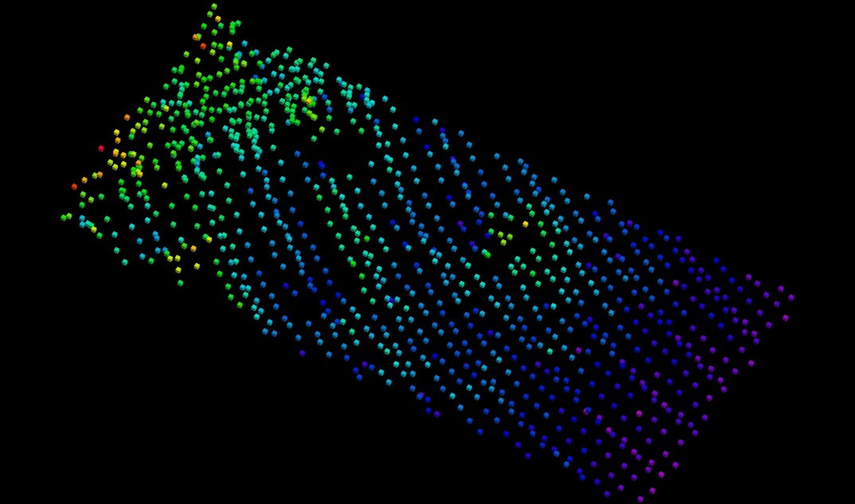
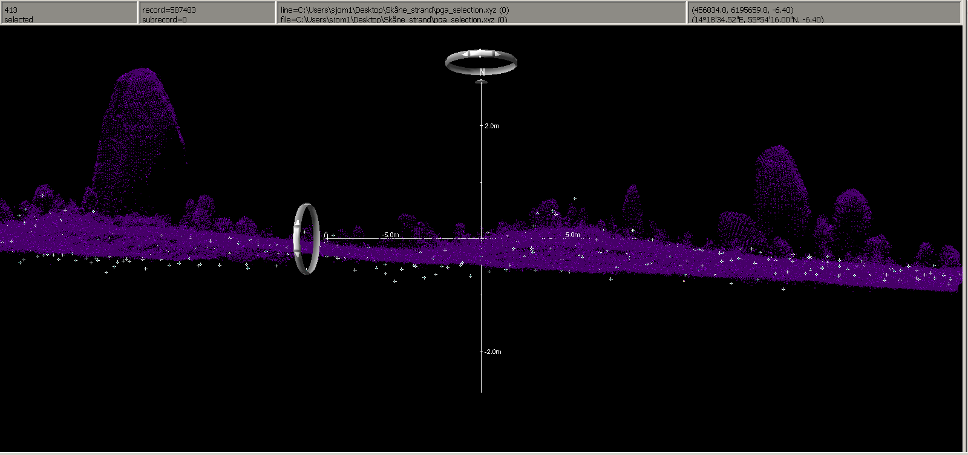
EMMA results: Feature detection – LIDAR versus multibeam
Boulder: 5x5 m och 3 m high
Multibeam:
Average depth: ~6 m
Shallowest sounding: 2,75 m
Boulder: 3x3 m och 2,2 m high
Hawkeye II:
Shallowest sounding at boulder position: ~5 m, no signs of bottom reflection on the boulders, processed XYZ-data (no raw data to analyze)
Purple points from multibeam
White points från Hawkeye II

Slide 6
Future LIDAR plans…
Project Surveying shallow waters 2104-2015
By direction of MSB – Swedish Civil Contingencies Agency
Project leader SMA Hans Öiås
To study:
Cost effective systems to map shallow waters < 10 m (coastal, lakes, rivers) towards the coast line
Analyze different acquisition techniques (LIDAR, echo-sounders)
Pros and cons: quality, costs, time, information
Survey plan on what system to use where
Practical field trials

