Slide 1
MaDaMe – Maritime Data Methods for Safe Shipping
Tero Jokela, Turku University of Applied Sciences

Slide 2
Project data
Duration: 1.11.2023-31.10.2026
Budget: 3,4 M€ (80% ERDF funding)
Coordinator: Turku University of Applied Sciences
Kick-off meeting: 13.-14.11.2023 @Turku

Slide 3
Project goal
The MaDaMe project develops and pilots
Digital Aids to Navigation information service incl. device status information
Digital Navigational Warnings information service
Digital technical VTS service
These services utilize technologies such as
Maritime Connectivity Platform (MCP)
VHF Data Exchange System (VDES)
These technologies are under international standardization and the MaDaMe project will contribute to the standardization in IALA and IHO.

Slide 4
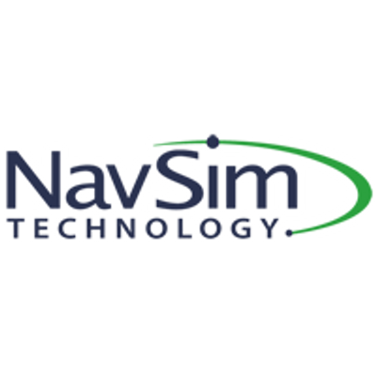
Consortium
Partners
Associate partners

Slide 5
Target groups
Maritime authorities are provided with opportunity to offer new services for ships
Ship owners making use of new digital services.
Digital service providers who develop equipment or solutions for authorities and ship owners
Standardization organizations

Slide 6
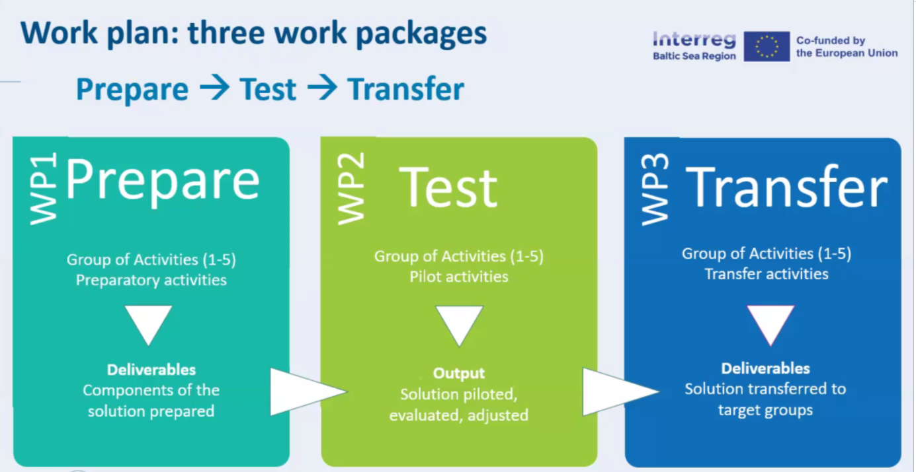
Connectivity and messaging of service information, Cybersecurity
Piloting WP1 Deliverables for selected services S-124, S-125, …
Contributions to IALA, IHO, MCP,…

Slide 7
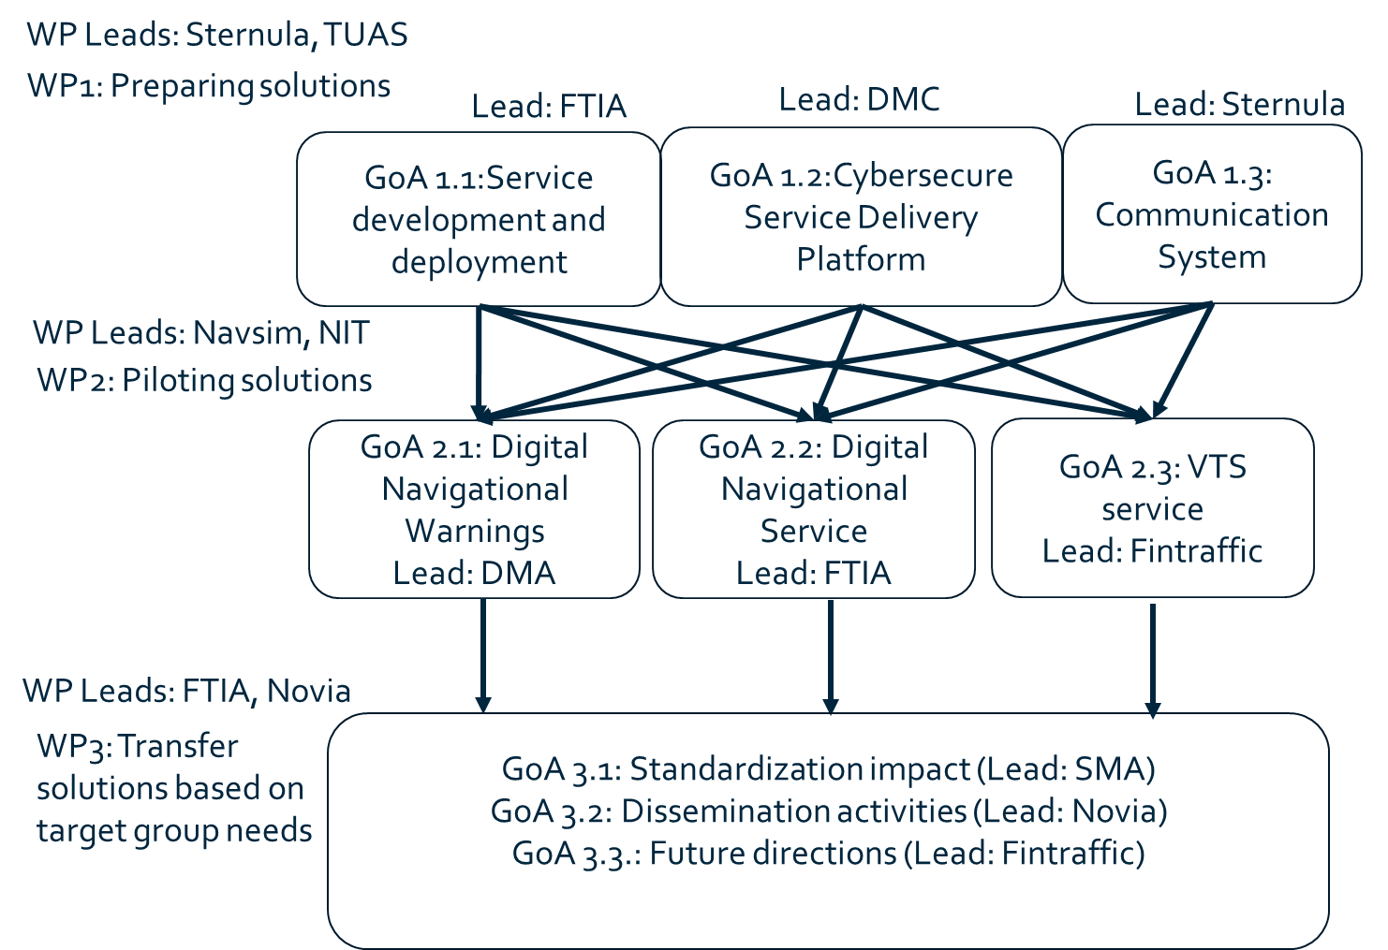
WPs and Group of Actions

Slide 8
WP1: Preparing solutions
GoA1.1 - Service development and deployment
Define requirements and operational procedures for the services (navigational warnings, Aids to Navigation information and VTS information)
GoA1.2 - Cybersecure Service Delivery Platform
Develop Maritime Connectivity Platform (MCP) for piloting the services
GoA1.3 - Communication System
Analyze the connectivity needs for the piloted services
Develop prototype VDES system for the pilots

Slide 9
WP2: Piloting solutions
GoA2.1 - Digital Navigational Warnings
Pilot the delivery of one S-124 service
GoA2.2 - Digital Navigational Service
Testing the Digital AtoN services in the testbed area of the Baltic Sea utilizing the VDES and MCP. The applications, focused on the S-125 framework, will be developed for a selected group of end-users (testers).
GoA2.3 - VTS service
Pilot and test electronic VTS services for ships and other maritime operators that can be integrated into the operational VTS system

Slide 10
WP3: Transfer solutions
GoA 3.1 - Standardization impact
IALA, IHO, MCC, IMO, Helcom
GoA 3.2 - Dissemination activities
BIMCO etc.
Other projects: ORMOBASS, Baltic eNav, etc.
Online training material explaining the developed services for each end-user group
GoA 3.3 - Future directions
Service deployment plan focusing on services prepared in WP1 and piloted in WP2.
Guidelines for future maintenance of developed services. Based on maturity analysis, life cycles of services are defined, reflecting the project outcomes and being aware of other future digitalization concepts and changing legislation. Attention is also given to cybersecurity as vulnerabilities are likely to found after the project duration.

Slide 11
Thank you! Questions? Tero Jokela, tero.jokela@turkuamk.fi Jarkko Paavola, jarkko.paavola@turkuamk.fi Heidi Tuominen, heidi.tuominen@turkuamk.fi

