Slide 1
NAVTEX Swedish Maritime Administration
Gustav Persson, System Engineer

Slide 2
NAVTEX specifications
Frequency: 518 kHz
Power: 1000 Watt
Bitrate: 100 bit/s

Slide 3
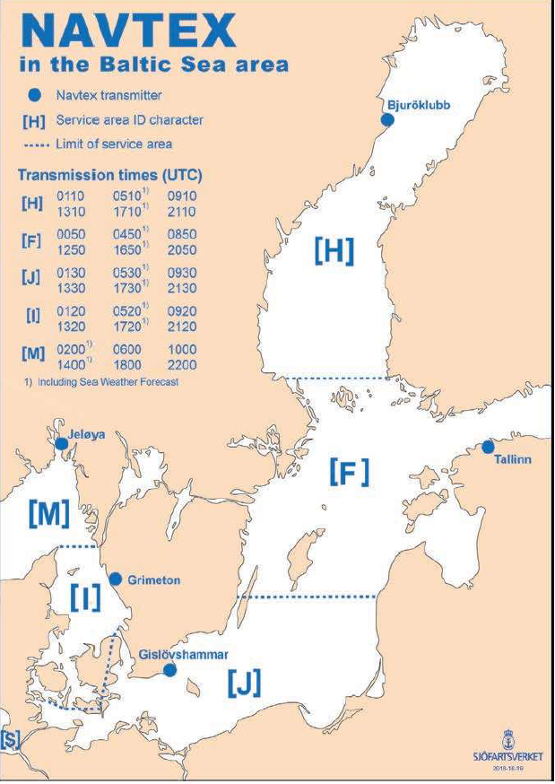
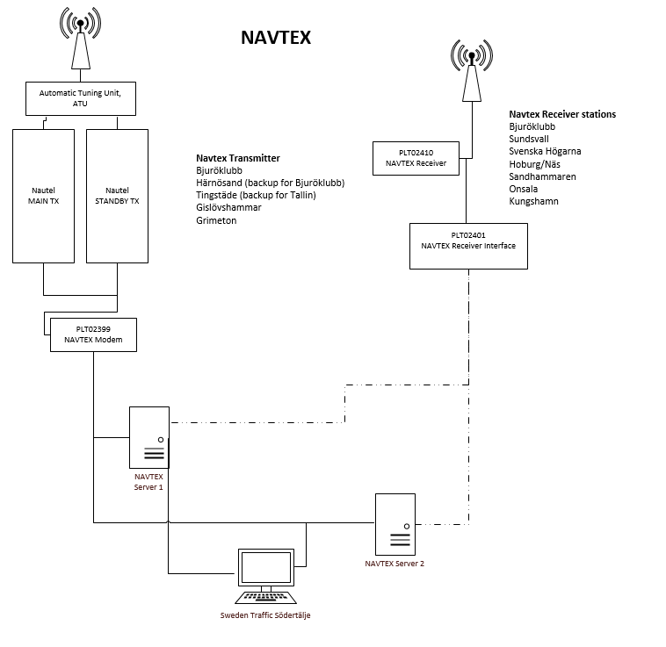
Swedish NAVTEX-system

Slide 4
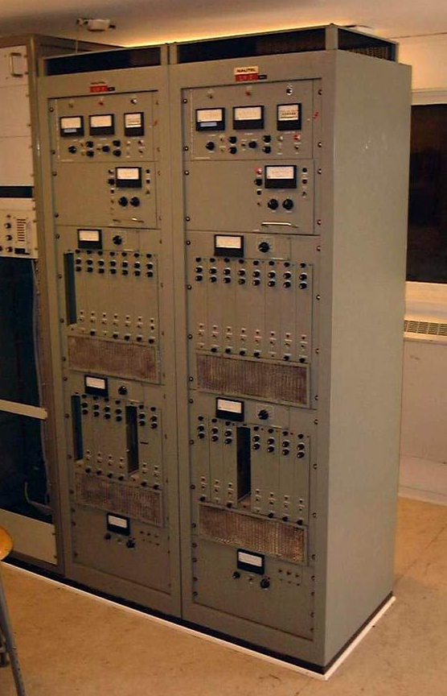
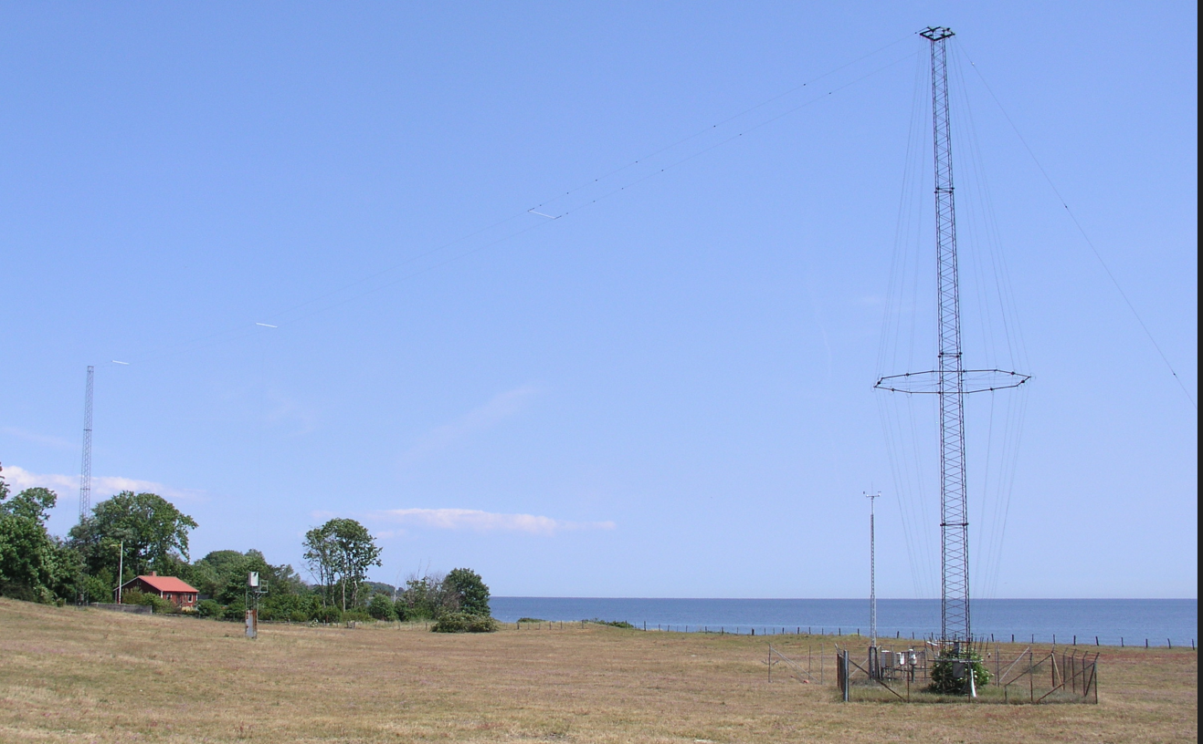
Transmitter Gislövshammar

Slide 5
Receiver Onsala

Slide 6
Thank you!

